Slide 1

Univ.AI AI-1 Cohort 2 | Project FIFA 20
Problem Statement FIFA 20
Football is arguably the most popular sport in the world and FIFA is the most popular football (soccer) simulation game by Electronic Arts (EA Sports).
Part A - Rank the Players
Part B - Classify player position
Part C - Which Club has the Best Staff
Presented By :
Abhineet Sharma | Adarsh Roy | Lokadithya Reddy | Nikhil Singh

Slide 2
Libraries Used
import numpy as np
import pandas as pd
from sklearn.preprocessing import StandardScaler
from sklearn.linear_model import LogisticRegression
from sklearn.preprocessing import LabelEncoder
from sklearn.metrics import classification_report , accuracy_score , f1_score
import matplotlib.pyplot as plt
import seaborn as sns
import plotly
import plotly.graph_objects as go
import plotly.express as px
from plotly.subplots import make_subplots
from sklearn.impute import SimpleImputer, KNNImputer
from sklearn.linear_model import LinearRegression
from sklearn.model_selection import train_test_split
from sklearn.metrics import mean_squared_error
from sklearn.linear_model import Lasso, Ridge

Slide 3
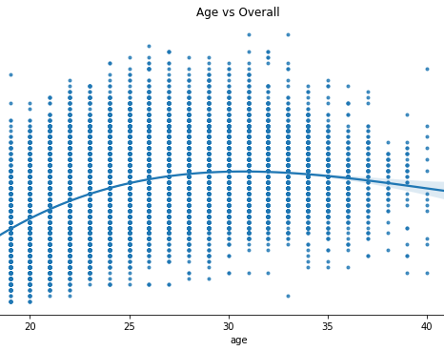
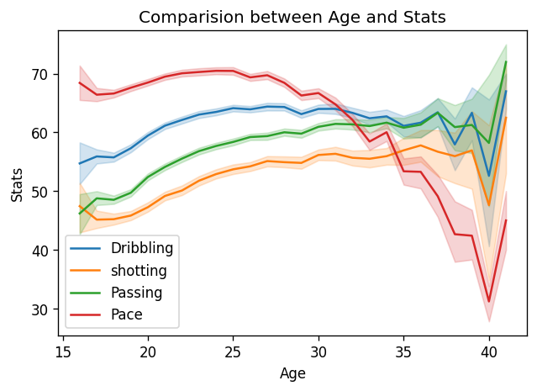
How Age affects the overall rating and stats [Part - A]
Max age of player= 45, min age of players= 16.
The age 25,27,32 belongs to the max players in top 20.
Overall rating increases with age.
Features like stamina, passing, dribbling, pace increases till certain age after which it goes down.

Slide 4
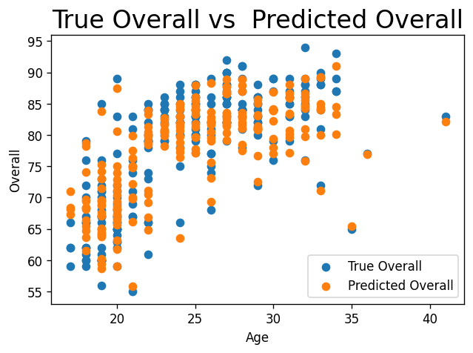
Comparison of Plots between True and Predicted values
We used Linear Regression, Lasso Regression and Ridge Regression for the prediction.
Comparing them, we found the least Test MSE for Ridge Regression.
MSEs for the models are:
Linear : Test - 9.56, Train - 4.01
Lasso : Test - 6.91, Train - 4.82
Ridge : Test - 6.91, Train - 4.01

Slide 5
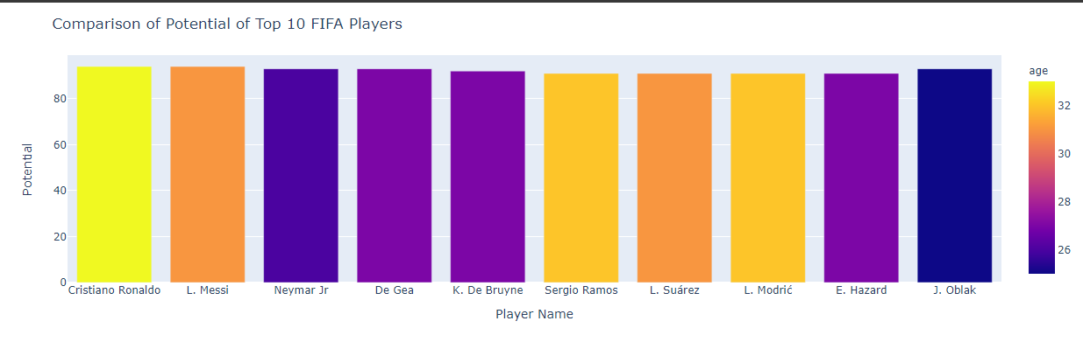
Best player according to our analysis
As per our Analysis over the datasets, we found that Cristiano Ronaldo is the best player in the FIFA game.

Slide 6
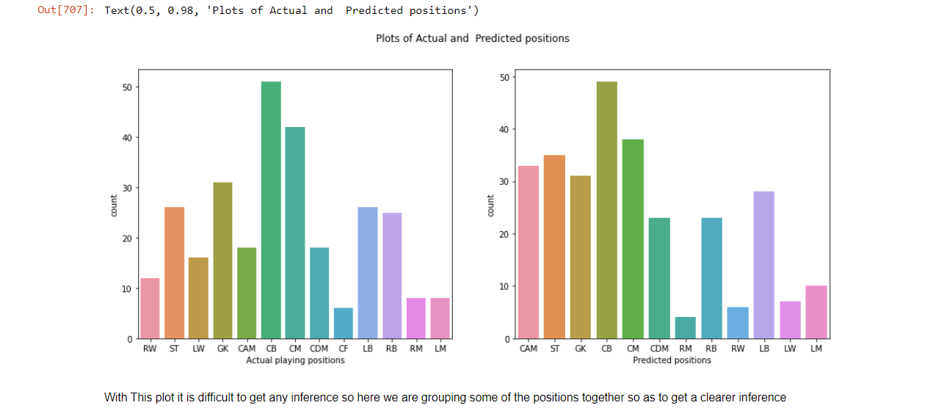
Classifying player position [Part -B] {Logistic Regression}
Accuracy Score of the Model = 0.7282229965156795
F1 Score of the Model = 0.7359154929577465

Slide 7
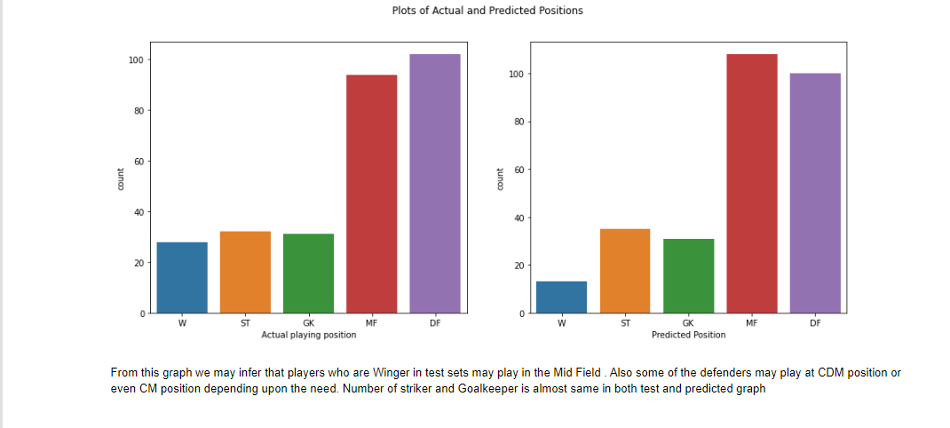
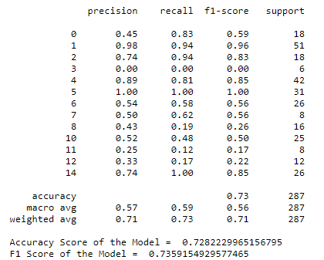
Final Inference as per our Model Predictions
Summary
1. The model has an accuracy of 0.73
2. The model has a weighted precision score of 0.71
3. The model has a weighted recall score of 0.73
4. The model has a weighted f1 score of 0.7

Slide 8
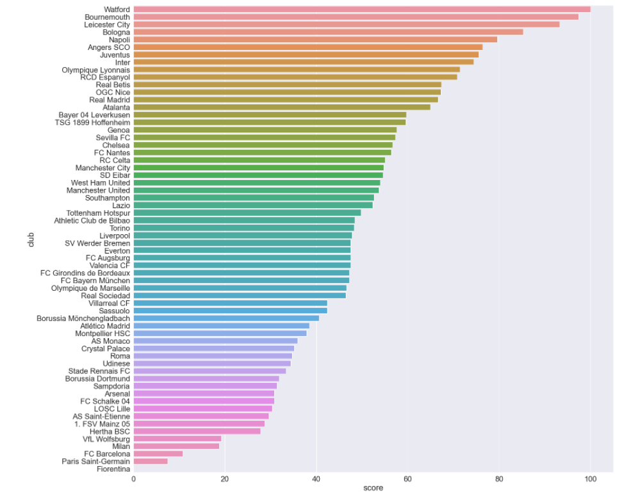
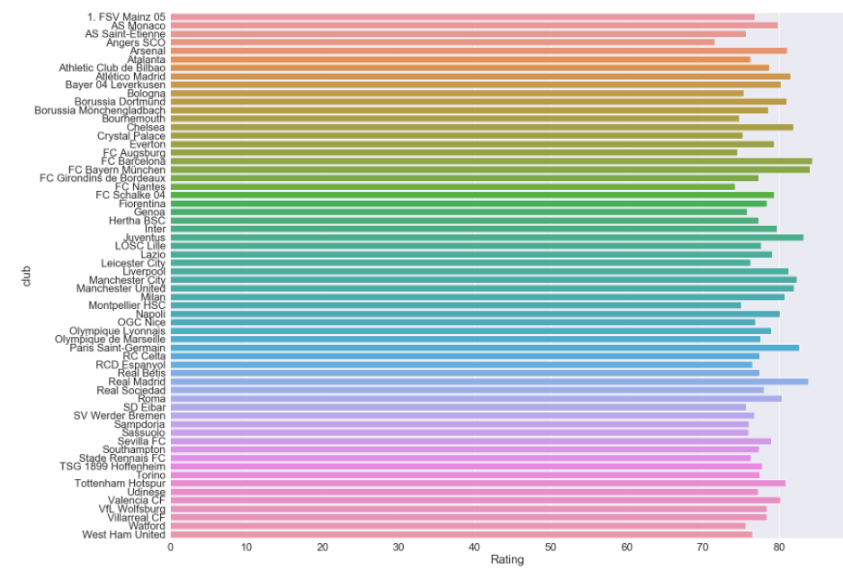
The Club that has the Best Staff [Part-C]
Normalized Dataset
Not Normalized

Slide 9
Potential Ability (sometimes abbreviated to PA) is an attribute for players and staff in Football Manager and in some Championship Manager games. It dictates the maximum that a person's Current Ability attribute can ever rise to, and therefore how good they can possibly become.
We Can say that the scope for improvement increases as the score for potential increases.
Hence, Players that belong to a club with high potential rating are still yet to match their rating

Slide 10

Thank You
Reference for DataSet:
You are given the following public dataset, scraped from https://sofifa.com. The data lists soccer players from the 2015-2020 editions of EA Sports FIFA video game. It consists of player positions, player attributes and personal data.

